Slide 1
Socket Programming
Socket Programming

Slide 2
What is a Socket?
An interface between application and network
The application creates a socket
The socket type dictates the style of communication
reliable vs. best effort
connection-oriented vs. connectionless

Slide 3
What can we do with sockets?
Once configured the application can
pass data to the socket for network transmission
receive data from the socket (transmitted through the network by some other host)

Slide 4
Java Sockets Programming
The package java.net provides support for sockets programming (and more).
Typically you import everything defined in this package with:
import java.net.*;

Slide 5
Classes
Socket
ServerSocket
DatagramSocket
DatagramPacket

Slide 6
Socket Class
Corresponds to active TCP sockets only!
Passive sockets are supported by a different class:
ServerSocket
UDP sockets are supported by
DatagramSocket

Slide 7
JAVA TCP Sockets
java.net.Socket
Implements client sockets (also called just “sockets”).
Constructor and Methods
Socket(String host, int port): Creates a stream socket and connects it to the specified port number on the named host.
InputStream getInputStream()
OutputStream getOutputStream()
close()

Slide 8
JAVA TCP Sockets
java.net.ServerSocket
Implements server sockets.
Waits for requests to come in over the network.
Performs some operation based on the request.
Constructor and Methods
ServerSocket(int port)
Socket Accept(): Listens for a connection to be made to this socket and accepts it. This method blocks until a connection is made.

Slide 9
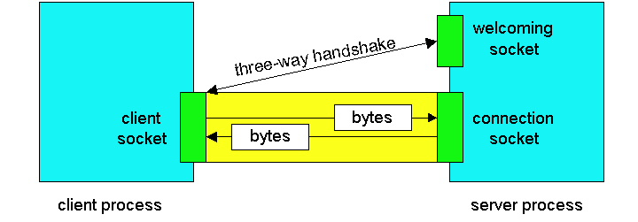
Sockets
Client socket, welcoming socket (passive) and connection socket (active)

Slide 10
Socket I/O
Socket I/O is based on the Java I/O support
java.io
InputStream and OutputStream are abstract classes

Slide 11
Client/server socket interaction: TCP
Server (running on hostid)
Client
create socket,
port=x, for
incoming request:
welcomeSocket =
ServerSocket()
TCP
connection setup
create socket,
connect to hostid, port=x
wait for incoming
connection request
connectionSocket =
welcomeSocket.accept()
clientSocket =
Socket()
send request using
clientSocket
read request from
connectionSocket
write reply to
connectionSocket
read reply from
clientSocket
close
connectionSocket
close
clientSocket

Slide 12
UDP Sockets
DatagramSocket class
DatagramPacket class needed to specify the payload
incoming or outgoing

Slide 13
UDP
Connectionless and unreliable service.
There isn’t an initial handshaking phase.
Transmitted data may be received out of order, or lost

Slide 14
JAVA UDP Sockets
java.net.DatagramSocket
A socket for sending and receiving datagram packets.
Constructor and Methods
DatagramSocket(int port): Constructs a datagram socket and binds it to the specified port on the local host machine.
void receive( DatagramPacket p)
void send( DatagramPacket p)
void close()

Slide 15
DatagramPacket
Contain the payload
A byte array
Constructor for receiving:
DatagramPacket( byte[] buf, int len);
Constructor for sending:
DatagramPacket( byte[] buf, int len InetAddress a, int port);

Slide 16
DatagramPacket Methods
byte[] getData();
void setData(byte[] buf);
void setAddress(InetAddress a);
void setPort(int port);
InetAddress getAddress();
int getPort();

Slide 17
Client/server socket interaction: UDP
Server (running on hostid)
Client
create socket,
port=x, for
incoming request:
create socket,
clientSocket =
DatagramSocket()
serverSocket =
DatagramSocket()
Create, address (hostid, port=x,
send datagram request
using clientSocket
read request from
serverSocket
write reply to
serverSocket
specifying client
host address,
port umber
read reply from
clientSocket
close
clientSocket

